Slide 1
NIHR using systematic reviews to inform funding decisions
Matt Westmore, Director of Finance and Strategy
Sheetal Bhurke, Research Fellow
NIHR Evaluation, Trials and Studies Coordinating Centre

Slide 2
Funding Acknowledgement:
This work was funded by the NIHR Evaluation, Trials and Studies Coordinating Centre
Department of Health Disclaimer:
The views and opinions expressed therein are those of the authors and do not necessarily reflect those of the NIHR, NHS or the Department of Health.
Emerging findings
The results presented here are still subject to peer review and so should be considered emerging findings

Slide 3
Summary
NIHR is a major funder of applied health research
New primary research will only be funded if it is based on a review of existing evidence
Reviews are used to support the research question and define methodology
70-75% of funded trials explicitly referenced a review in their applications as justification for the research question
100% of funded trials that could, referenced a review to inform the research question and/or design

Slide 4


Slide 5
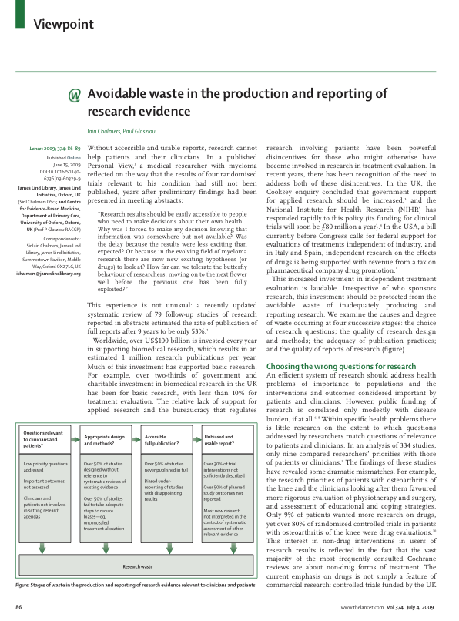
85% of Health Research Funding is wasted avoidably
Sir Iain Chalmers and Paul Glasziou
‘Avoidable waste in the production and reporting of research evidence’, The Lancet, Volume 374, Issue 9683, Pages 86 - 89, 4 July 2009,
Notes:
5

Slide 6
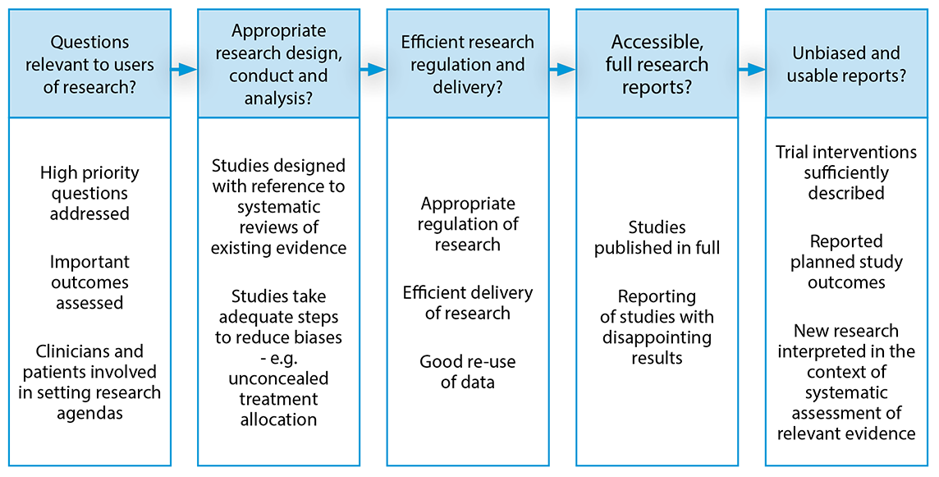
Adding Value in Research Framework
Google “NIHR adding value in research framework”
Notes:
End of day

Slide 7

Google “NIHR adding value in research framework”
http://www.nets.nihr.ac.uk/__data/assets/pdf_file/0006/77217/Guidance-notes_literature-review.pdf

Slide 8
What do we mean by a systematic review
New primary research will only be funded if it is based on a review of existing evidence that is credible to your peers and:
Is completed according to a predetermined methodology
Methodology is adequately described to allow, in principle, replication by others
Has well defined and justified inclusion and exclusion criteria
Minimises bias and random error in a way proportionate to the risk of an inappropriate funding decision
Maximises completeness in a way proportionate to the risk of an inappropriate funding decision
References ongoing studies
Critically appraises for quality and relevance
Synthesises

Slide 9
Who does what?
If it is a commissioned call – we have done it so applicant does not have to.
If not applicant does it
  If a published review exists – use it adding in any more recent studies
  If a published review does not exist review the evidence systematically
  We check

Slide 10
Bhurke et al “Are Health Technology Assessment (HTA) funded trials using systematic reviews to inform their design? A retrospective cohort”
 | 2006-9 | 2013
Did not reference a systematic review | 5 trials (11%) | 0 trials (0%)
Referenced a systematic review | 42 trials (89%) | 34 trials (100%)
Referenced more than one systematic review | 30 trials (77%) | 20 trials (65%)
Total Cochrane reviews referenced | 27 | 16
EMERGING FINDINGS – SUBJECT TO PEER REVIEW

Slide 11
What were they used for? | Cohort I Number (%) (n = 42) | Cohort II Number (%) (n = 34)
Adverse events | 7 (16.6) | 1 (2.9)
Choice of frequency/dose | 2 (4.7) | 1 (2.9)
Duration of follow-up | 1 (2.3) | 2 (5.8)
Estimating the control group event rate | 2 (4.7) | 0 (0)
Estimating the difference to detect or margin of equivalence | 2 (4.7) | 1 (2.9)
Inform standard deviation | 0 (0) | 3 (8.8)
Intensity of interventions | 1 (2.3) | 1 (2.9)
Justification of prevalence | 3 (7.1) | 0 (0)
Justification of treatment comparison | 38 (90.4) | 32 (94.1)
Recruitment and consent | 4 (9.5) | 1 (2.9)
Route of intervention | 0 (0) | 1 (2.9)
Selection of definition or outcome | 5 (11.9) | 5 (16.1)
Withdrawal rate | 1 (2.3) | 0 (0)
EMERGING FINDINGS – SUBJECT TO PEER REVIEW

Slide 12
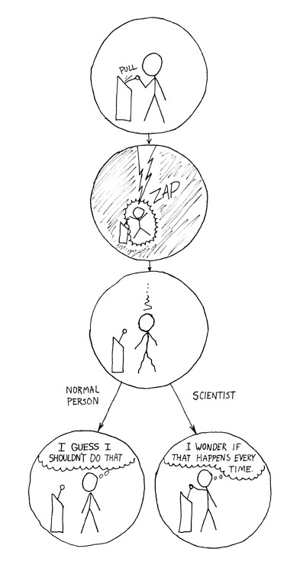
Summary
NIHR is a major funder of applied health research
New primary research will only be funded if it is based on a review of existing evidence
Reviews are used to support the research question and define methodology
70-75% of funded trials explicitly referenced a review in their applications as justification for the research question
100% of funded trials that could, referenced a review to inform the research question and/or design
Thank you

