Slide 1
Evidence-Based Research. How can we avoid needless research and ensure research covering important knowledge gaps?
Hans Lund
University of Southern Denmark
Bergen University College

Slide 2
The Scientific Ideal

Slide 3
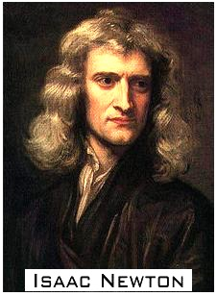
BACKGROUND
The scientific ideal
"If I have seen farther it is by standing on the shoulders of giants"
Letter to Robert Hooke,
15. February 1676.
1643 - 1727

Slide 4
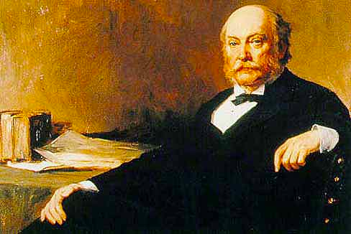
BACKGROUND
The scientific ideal
“If, as is sometimes supposed, science consisted in nothing but the laborious accumulation of facts, it would soon come to a standstill, crushed, as it were, under its own weight……
The work which deserves, but I am afraid does not always receive, the most credit is that in which discovery and explanation go hand in hand, in which not only are new facts presented, but their relation to old ones is pointed out.”
Lord Rayleigh at the 54th meeting of the British Association for the Advancement of Science held in Montreal in 1884.
(Thanks to I. Chalmers, LV Hedges, H Cooper, 2002)

Slide 5
The scientific ideal
"The Helsinki Declaration states that biomedical research involving people should be based on a thorough knowledge of the scientific literature. That is, it is unethical to expose human subjects unnecessarily to the risks of research.
Ideally, the introduction should include a reference to a systematic review of previous similar trials or
a note of the absence of such trials."
Altman et al 2001

Slide 6
The assumption

Slide 7
The assumption
One would think:
No paper has ever been published without references to earlier published scientific results. What's the problem?

Slide 8
The assumption
“Strictly speaking it seems hard to imagine any research not evidence-based. At least it seems impossible to imagine that articles published in journals with a high impact factor do not relates to earlier research"
Norwegian Accreditations Committee, in 2014 (nokut.no)

Slide 9
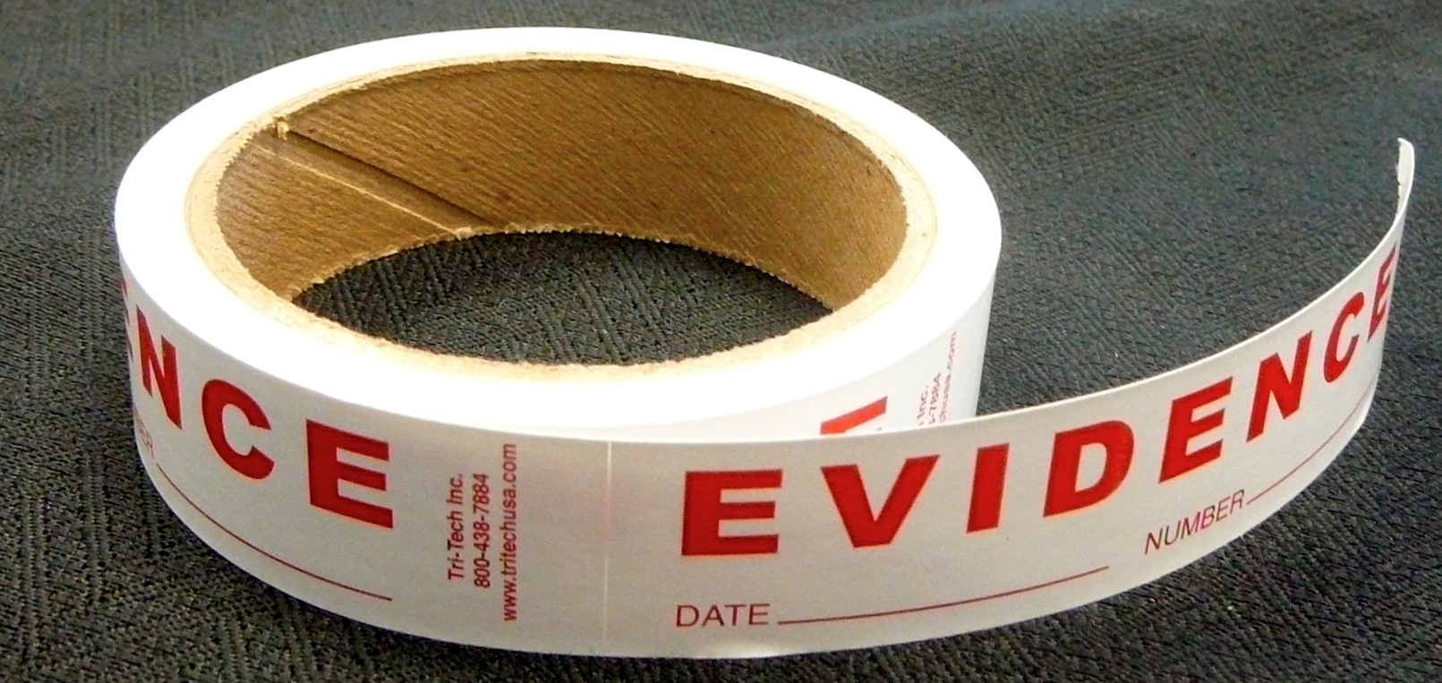
The evidence

Slide 10
The evidence
CONSORT states:
"Ideally, the introduction should include a reference to a systematic review of previous similar trials or a note of the absence of such trials".
What are the evidence for researchers per-forming SYSTEMATIC REVIEWS before perfor-ming new research?

Slide 11
The evidence
SYSTEMATIC means:
Predefined question
Predefined inclusion criteria
Predefined search method and selection procedure. No selection of studies – all studies should be included (exhaustive summary of current literature relevant to a research question.)
Predefined quality assessment
Predefined data-extraction and analysis
The results from each study justify the conclusion

Slide 13
Studies will differ!
the characteristics of the participants,
the design and execution of the trial,
the treatment administration or dosage,
concomitant exposures,
outcome assessment
the local health care system,
the way the investigational site is organized
etc…
Borm 2009
Notes:
Even when multiple trials are designed to address the same question, their results and conclusions may differ. Possible explanations for these differences are:
….
However, it is often impossible to identify exactly which factor(s) caused the differences between the results [4] . This (unexplained) heterogeneity means that study results must be interpreted with caution.

Slide 14
Studies will differ!
When only one trial has been carried out, there is no information available about possible heterogeneity; hence, it may not be prudent to generalize the results.
the characteristics of the participants,
the design and execution of the trial,
the treatment administration or dosage,
concomitant exposures,
outcome assessment
the local health care system,
the way the investigational site is organized
etc…
Borm 2009
Notes:
Even when multiple trials are designed to address the same question, their results and conclusions may differ. Possible explanations for these differences are:
….
However, it is often impossible to identify exactly which factor(s) caused the differences between the results [4] . This (unexplained) heterogeneity means that study results must be interpreted with caution.

Slide 15
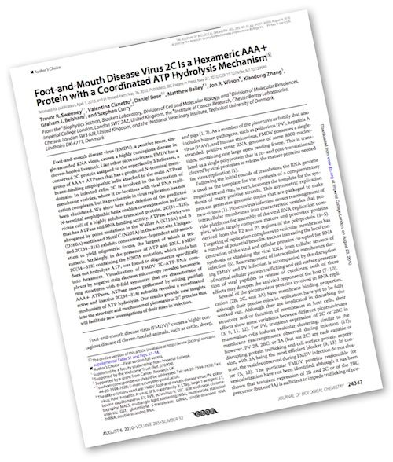
The evidence
Are we as researchers referring to single studies or systematic reviews including all studies?
Notes:
Even when multiple trials are designed to address the same question, their results and conclusions may differ. Possible explanations for these differences are:
….
However, it is often impossible to identify exactly which factor(s) caused the differences between the results [4] . This (unexplained) heterogeneity means that study results must be interpreted with caution.

Slide 16
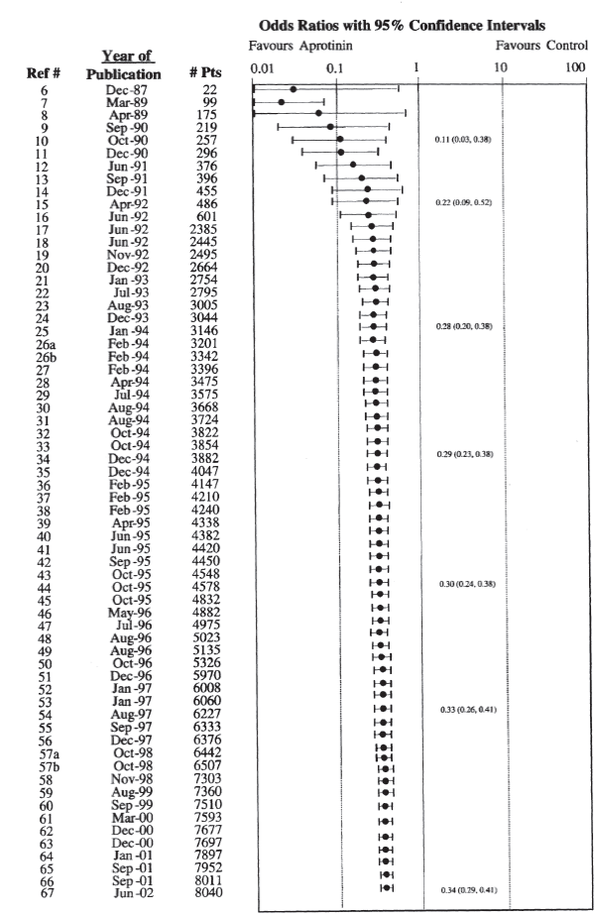
The evidence
Trials testing aprotinin in cardiac surgery.
After 1994:
More than 2500 received unnecessary placebo!
Fergusson et al. 2005

Slide 17
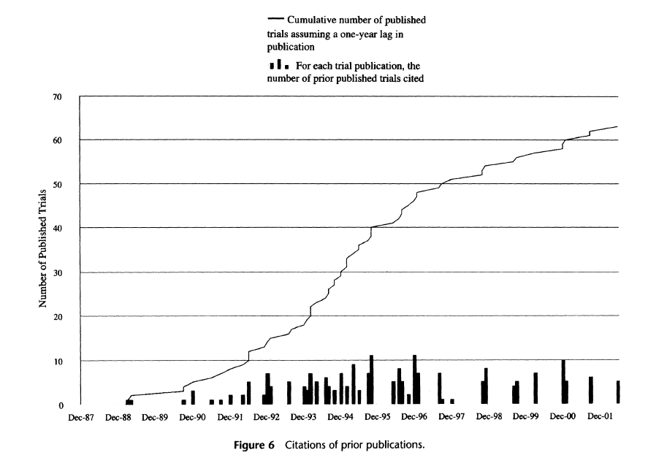
The evidence
?
Fergusson et al. 2005

Slide 18
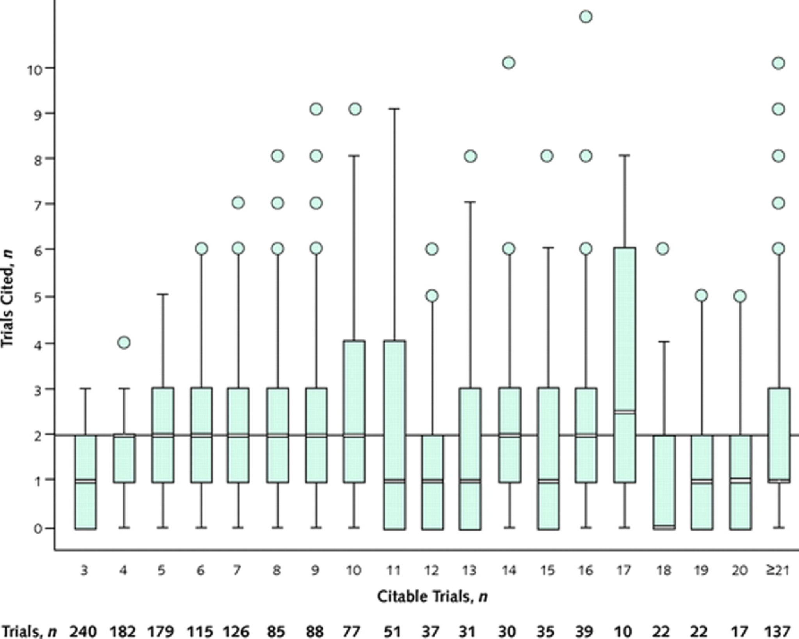
The evidence
A Systematic Examination of the Citation of Prior Research in Reports of Randomized, Controlled Trials
Robinson et al. 2011

Slide 19
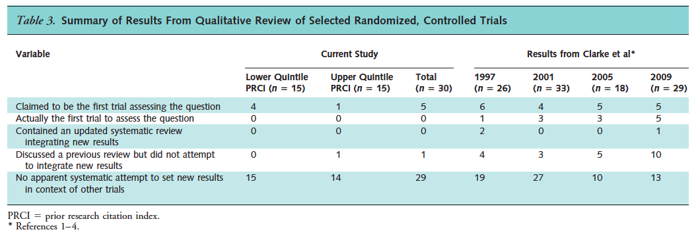
Robinson 2011
The evidence
Papers from the highest impact medicine journals
Robinson 2011, Clarke, Chalmers, 1997, 2001, 2005, 2009

Slide 20
The evidence
J Lau et al. New England Journal of Medicine, 1992
CUMULATIVE META-ANALYSIS

Slide 21
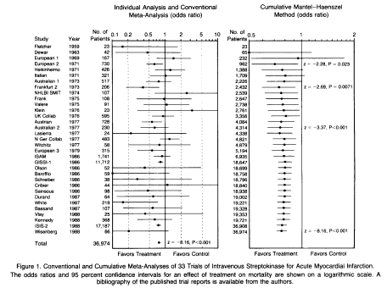
The evidence

Slide 22
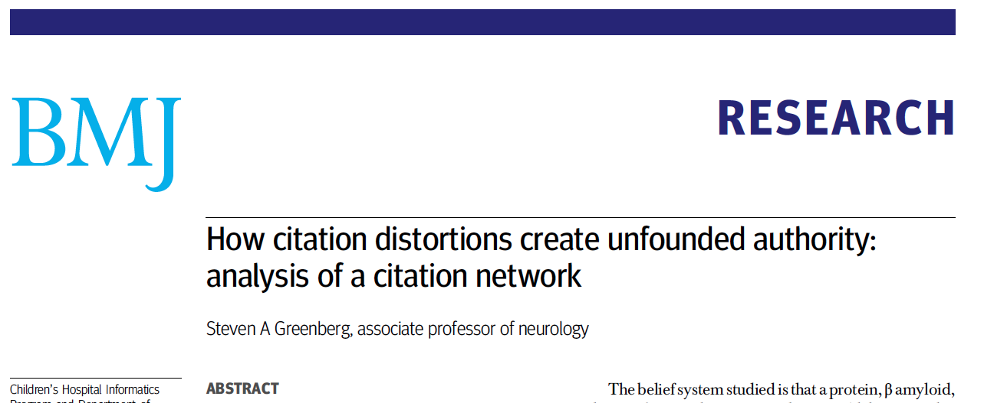
The evidence
SA Greenberg et al., BMJ 2009
CITATION NETWORK

Slide 23
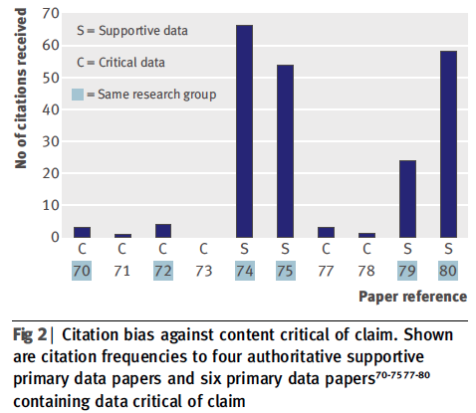
The evidence

Slide 24
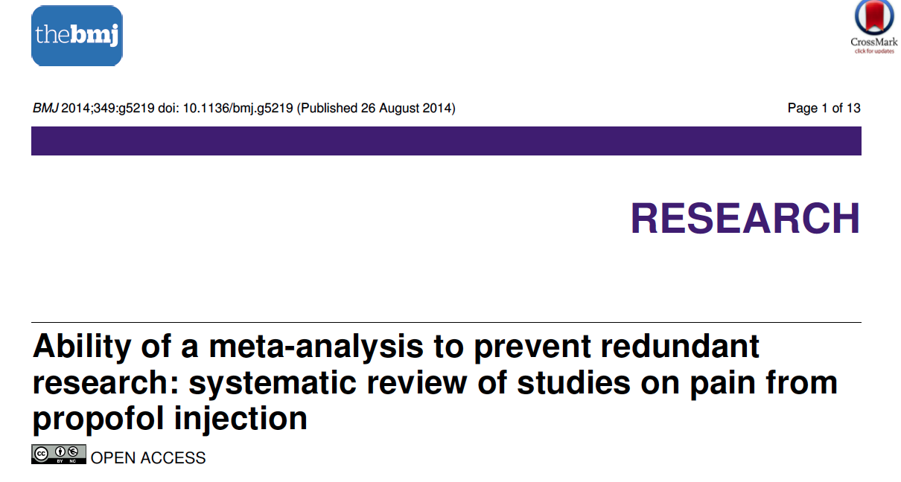
The evidence
Habré et al. BMJ, 2014
SUPERFLUOUS STUDIES

Slide 25
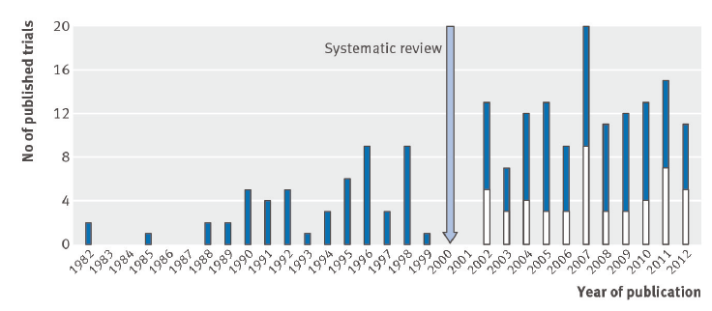
The evidence

Slide 26
The solution
To address this problem a group of researchers have initiated an international network, the ‘Evidence-Based Research Network’ (EBRNetwork).
http://ebrnetwork.org/

Slide 27
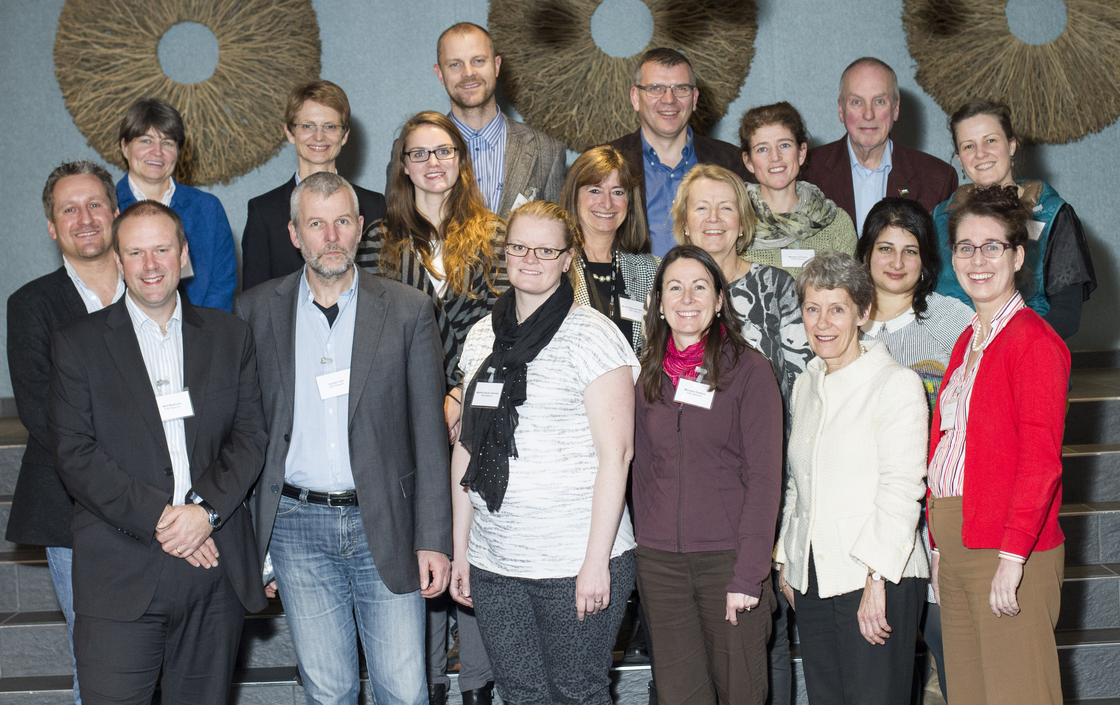
The solution
Establishing the ‘Evidence-Based Research Network’ (EBRNetwork): 1. and 2. December 2014 in Bergen, Norway.

Slide 28
The solution
At the ‘Bergen meeting’ (December 2014) part-ners agreed the aim of the EBRNetwork is to reduce waste in research by promoting:
No new studies without prior systematic review of existing evidence
Efficient production, updating and dissemination of systematic reviews

Slide 29
The solution
The EBRNetwork now issues a call for interested individuals and organizations to join the EBRNetwork and work together in developing a consensus statement to address this challenge to the very heart and values of research.

Slide 30
Mike Clarke
”Including an updated systematic review along with a report of a randomised trial (or any other piece of research) might seem too much to expect of researchers, who might not feel able or willing to do the additional work required.
However, the absence of a review should raise the question: on what did the researchers base the design of their new study?
To embark on a new study without first systematically reviewing what has been done before is to risk doing research for which the answer is already known."
Clarke M (2004) Doing new research? Don’t forget the old. PLoS Med 1(2): e35.

Slide 31
TWO BASIC EBR PAPERS UNDER PREPARTION
Evidence-Based Research. An introduction and a systematic review.
The Bergen Statement about Evidence-Based Research.

Slide 32
IMPLICATIONS
No new studies without prior systematic review of existing evidence

Slide 33
EBRNetwork have identified …
Implications for
Researchers
Educators
Ethic Committees
Funding agencies
Editors

Slide 34
EBRNetwork have identified …
Implications for
Researchers
Educators
Ethic Committees
Funding agencies
Editors
What implications do you think EBR have for these groups?

Slide 35
Clarke, Hopewell, Chalmers
” The expectation that the results of a new randomized trial will be reported in the context of an up-to-date systematic review of earlier trials does not imply that the Discussion section of every report of a randomized trial should contain a full account of the material, methods and findings of such a review.
The technology already exists to enable a brief review to be included in the Discussion section, with links to a relevant, up-to-date systematic review published elsewhere.
And, now, with 3000 Cochrane reviews published in The Cochrane Library and protocols published for 1600 more, the availability and ready accessibility of systematic reviews has never been greater.”
Clarke, Hopewell, Chalmers, J R Soc Med 2007;100:187–190

Slide 36
EBRNetwork have identified …
Further research is needed:
Is researchers really performing EBR?
How to write the Introduction incorporating systematic reviews of existing evidence.
Animal studies - Clinical research - Epidemiological research - Humanistic research - Physiological and/or biomechanical research - Social Science research
How to write the Discussion incorporating systematic reviews of existing evidence.
Animal studies - Clinical research - Epidemiological research - Humanistic research - Physiological and/or biomechanical research - Social Science research
When is enough enough? Methods to decide when a new study would add new knowledge or would be redundant. An evidence-based research approach when preparing new scientific studies.

Slide 37
IMPLICATIONS
Efficient production, updating and dissemination of systematic reviews

Slide 38
EBRNetwork have identified …
Different kinds of systematic reviews: Cochrane Review type (huge task) Introduction type of reviews
How can we automate the different part of the SR process
What is the evidence for the way we perform a SR to day is the best way?

Slide 39
EBRNetwork have identified …
Different kinds of systematic reviews: Cochrane Review type (huge task) Introduction type of reviews
What can be left out in a "Introduction type of review" compared to a "Cochrane type of Review"?
What about the quality of the SR and thus the conclusion?

Slide 40
EBRNetwork have identified …
What is the evidence for the way we perform a SR to day is the best way?
Are the librarians ready to acknowledge their responsibility for that?
Is it possible to show the evidence for our methods?

Slide 41
Thank you for your attention!

