Slide 1
EBRNetwork COST Action EVBRES (2018 – 2023): Structure and Accomplishments
Klara Brunnhuber
EBRNetwork Seminar
Advancing Evidence-Based Research: Trends and Insights
4th December 2023

Slide 2
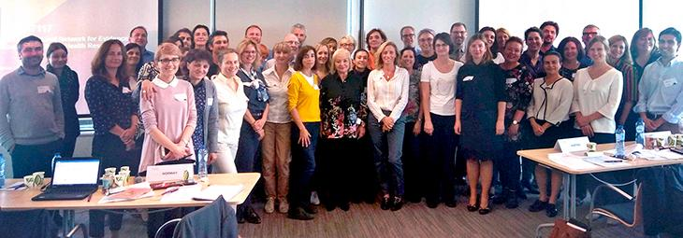
EVBRES (EVidence-Based RESearch)
EVBRES was a 4.5-year (2018-2023) EU-funded COST Action CA-17117 with over 40 countries participating globally
Our aim: To encourage researchers and other stakeholders to use an Evidence-Based Research (EBR) approach while carrying out and supporting clinical research – and thus avoiding redundant research
EVBRES Launch
Brussels
17th October 2018

Slide 3
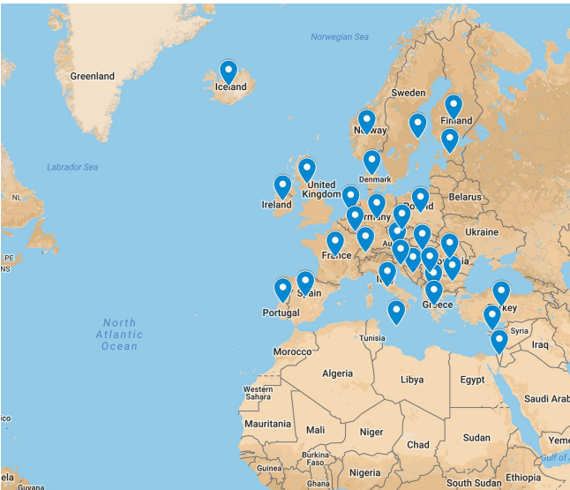
32 Full Member Countries
EVBRES Launch
Brussels
17th October 2018

Slide 4
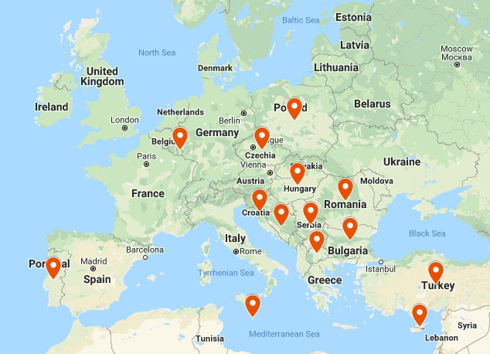
16 Inclusiveness Target Countries
EVBRES Launch
Brussels
17th October 2018

Slide 5
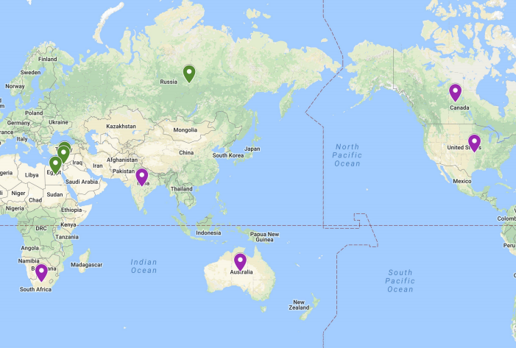
4 Near Neighbouring Countries
EVBRES Launch
Brussels
17th October 2018
5 International Partner Countries

Slide 6
Main Aim
EBR Approach
↓
Reduced waste in research
Theme
Dissemination & Implementation
(Stakeholders)
EBR methods
Systematic review efficiency
Meta-research on EBR implementation
Objective 1:
Research Coordination
Raise awareness
Develop teaching materials
Foster
Collaboration
Assess effort
Build agreement on how to evaluate
Objective 2:
Capacity Building
Formulate implications
Provide training
Develop Handbook
Improve processes & Technologies
Build understanding of how to monitor
Working Groups
1
2
3
4

Slide 7
Main Aim
EBR Approach
↓
Reduced waste in research
Theme
Dissemination & Implementation
(Stakeholders)
EBR Methods
Systematic Review Efficiency
Meta-Research on EBR Implementation
Working Groups
1
2
3
4
Objective 1:
Research Coordination
Raise Awareness of the Problem
Develop EBR Teaching Materials
Foster
Collaboration
& Assess Effort
Build Agreement on how to Evaluate
Objective 2:
Capacity Building
Formulate Implications for Stakeholders
Provide Training
& Develop Handbook
Improve Processes & Technologies
Build Understanding of how to Monitor

Slide 8
EVBRES Organisational Structure
Action Management Committee
Chair &
Vice-Chair
CORE TEAM
Grant Holder Man
Advisory Group
Grant Holder
Programme Management Group
Consultant Group
Science Com Man
WG/GC Representatives
WG1
WG2
WG3
WG4
GRANTS
COMMITTEE
A1
A2
A3
A13
A4
A5
A6
A7
A8
A14
A15
A9
A10
Communicate with
Provide input
Work on

Slide 9
EVBRES in Numbers:
7
Training Schools
4
Working Groups
597
32
1
EBR Training School registrants
Full member countries at kick-off
EBR Handbook
3
24
15
Short-term scientific missions and conference grants
Online EBR Conferences
Activity Groups
28
65
24
Scientific publications
Core Group and Action MC Meetings
EVBRES participants
€378,833
>21,560
People reached through media
Allocated COST budget

Slide 10
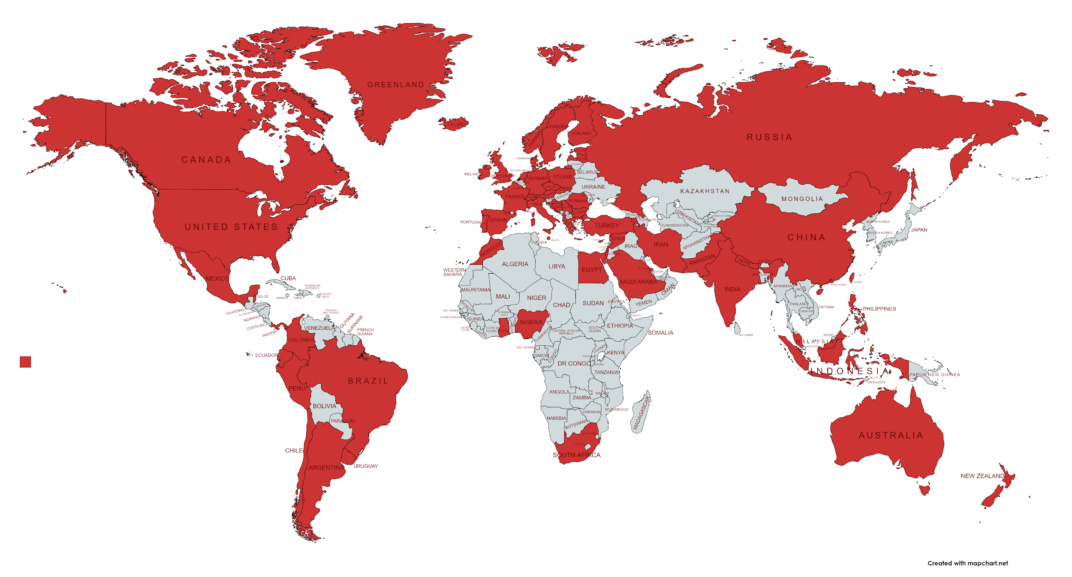
Our 1st EBR Conference
773 registered participants from
70 countries across
6 continents
Top five countries:
China: 312
UK: 82
Norway: 59
Mexico: 36
Spain: 18

Slide 11
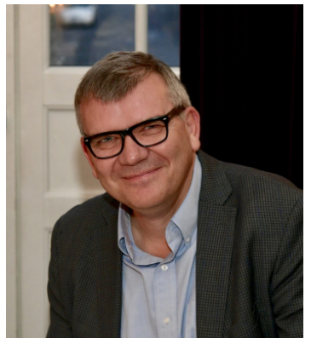
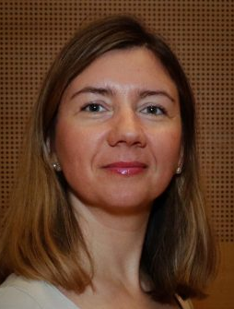
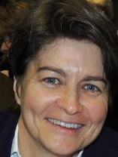
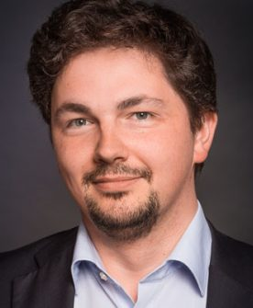
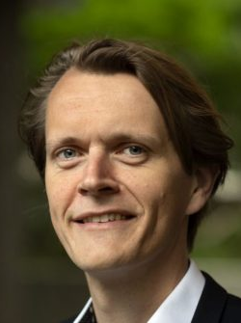
EBR Conferences: Our Amazing Plenary Speakers
Hans Lund*
Livia Puljak*
Jennifer Yost*
Gabriel Rada*
Mike Clarke*
Karen Robinson*
Dawid Pieper*
Guy Tsafnat*
Jong Wook Ban*
Daeria Lawson
Lawrence Mbuagbaw
Maureen Dobbins
Paul Glasziou
Julian Savulescu
Alex Sutton
Rieke van der Graaf
Taryn Young
Lesley Stewart
* EVBRES members
Michel Shamy
Per Olav Vandvik
Heather Munthe-Kaas
Arianne Verhagen
Jeremy Grimshaw
Jennifer Johannesen
Joeri Tijdink
James Barker
Notes:
The ethical aspect of EBR: the question of valuable research

Slide 12
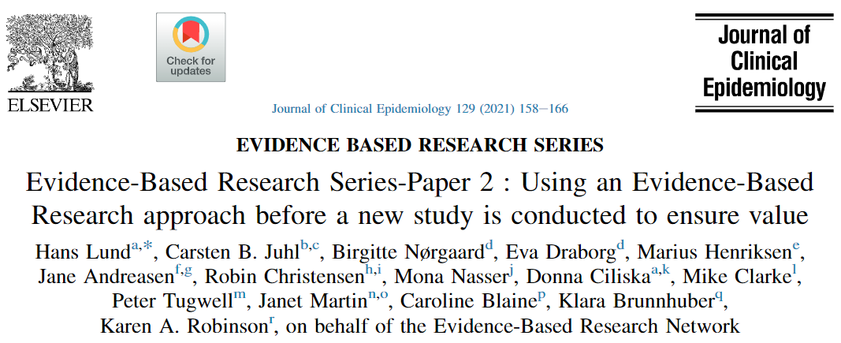
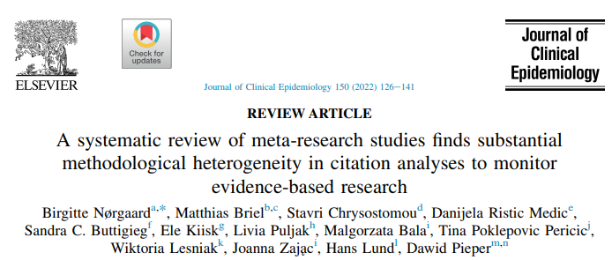
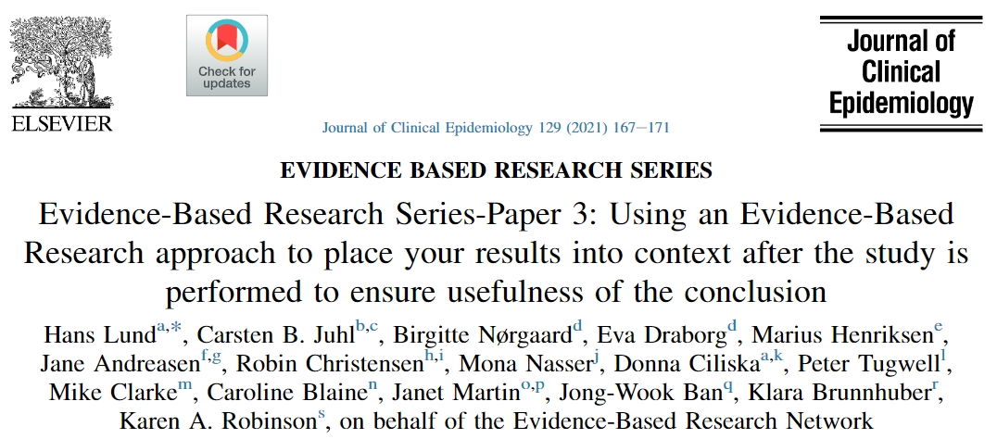
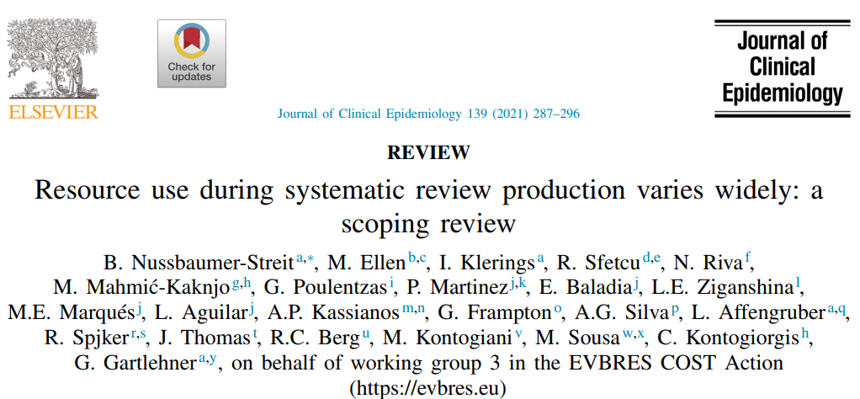
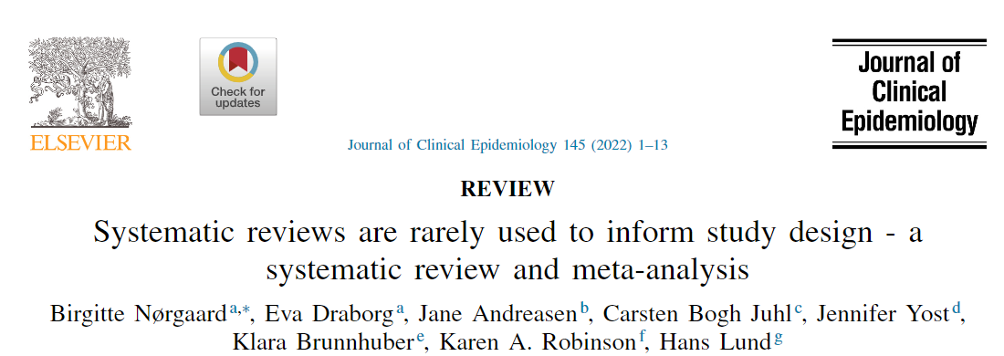
5 EBR articles published in the Journal of Clinical Epidemiology
https://www.jclinepi.com/

Slide 13
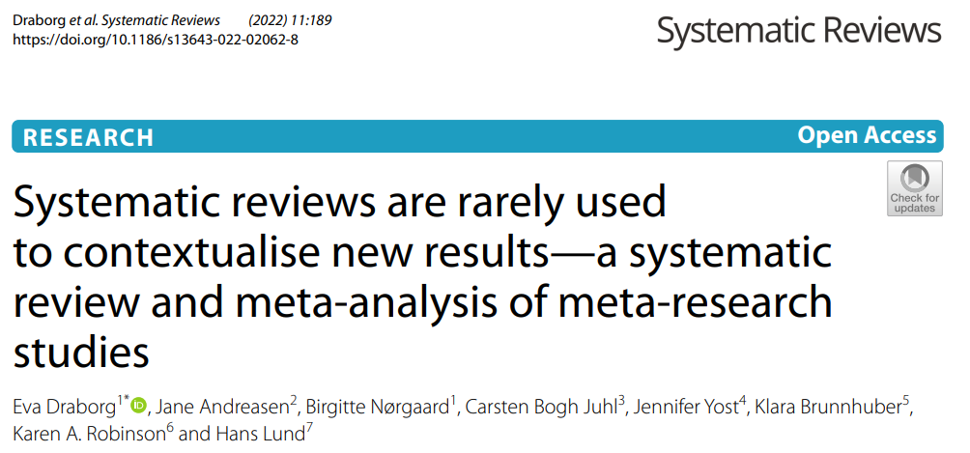
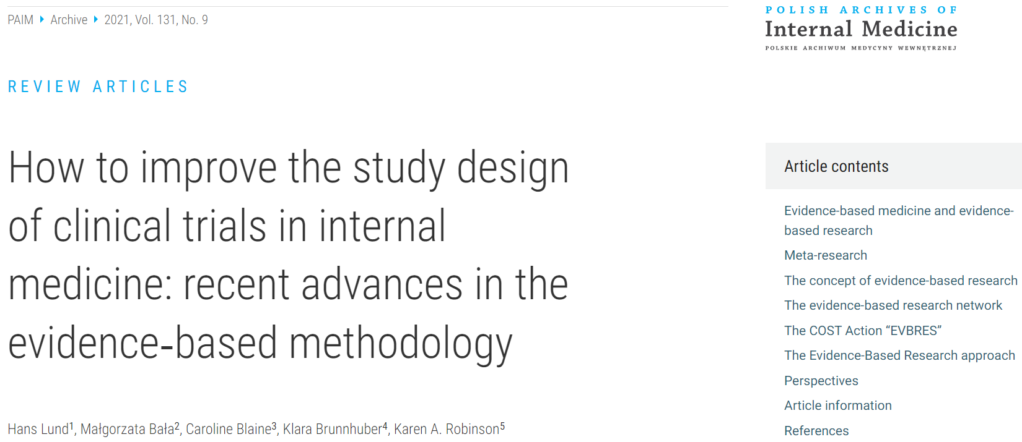
Some Other Key EVBRES Publications
…all open access, thanks to COST funding!

Slide 14
6 Major Projects Resulting from EVBRES
Project | Participating Countries | Funding
Towards an International Network for Evidence-Based Research in Clinical Health Research in the Czech Republic | Czech Republic | National
Czech-Norway Evidence-Based Healthcare collaboration on Meta-Research and Critical Thinking Education in Healthcare | Czech Republic, Norway | Transnational
Evidence Implementation in Clinical Practice | Czech Republic, Germany | Other EU
Towards Implementation of an Evidence-Based Approach in Clinical Research | Switzerland | National
Teaching Evidence Based Research with a Focus on Ambient Assisted Living | Norway, Slovakia | Transnational
Towards Implementation of an Evidence-Based Approach in Clinical Research | Austria, Croatia, Ireland, Norway, Switzerland | National

Slide 15
EVBRES Impact
Stakeholder impact: Funders are starting to follow the EBR principles (see EVIR.org)
Publications:
Translations of the 2016 BMJ article ‘Towards EBR’ (cited by 75 publications) into 9 languages
High citation rate of EBR related papers (for the publications before 2022: average of 31 citations)
Education:
PhD course at HVL: Introduction to systematic review (SR) and the use of SR in social science research
EBR Training Schools have been used as part of PhD courses, with participants reporting that they have gained knowledge and skills for finding, preparing, and publishing systematic reviews, and for applying an EBR approach to their research
Collaborations: Maria Curie "MiRoR“, Basel University (Switzerland), Cochrane Netherland, Czech National Centre for Evidence-Based Healthcare and Knowledge Translation and Masaryk University (Czech Republic), Comenius University Bratislava (Slovakia), University for Continuing Education Krems (Austria), University of Southern Denmark and Aarhus University (Denmark), University of Bucharest (Romania), Villanova University (USA)
New research positions:
Guest Professor and Postdoc positions in Evidence-Based Research at Western Norway University of Applied Sciences (HVL)
Networking within the EVBRES community has resulted in a number of participants obtaining new positions, including one participant moving from Sri Lanka to start a new EBR research role at HVL, Norway.

Slide 16
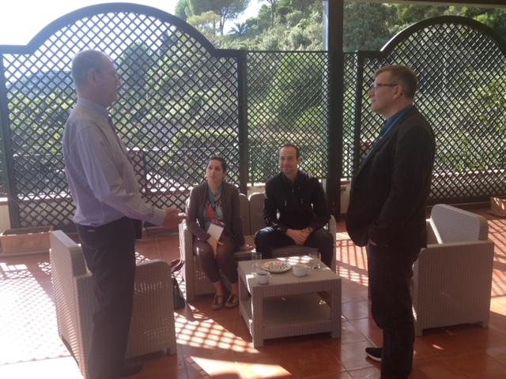
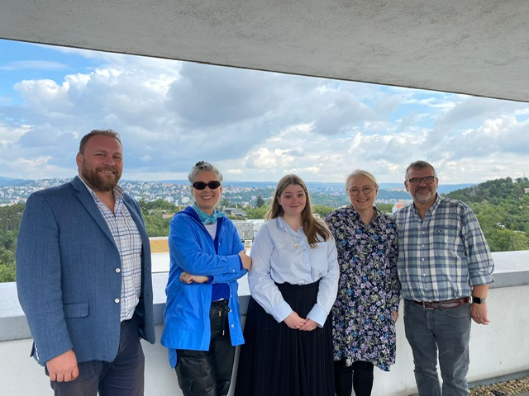
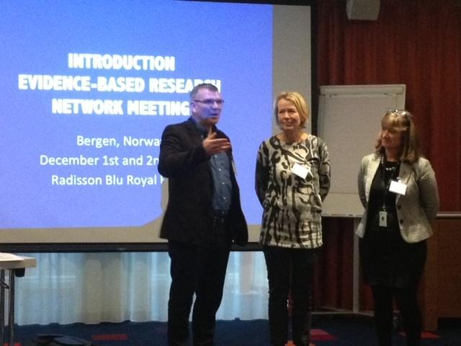
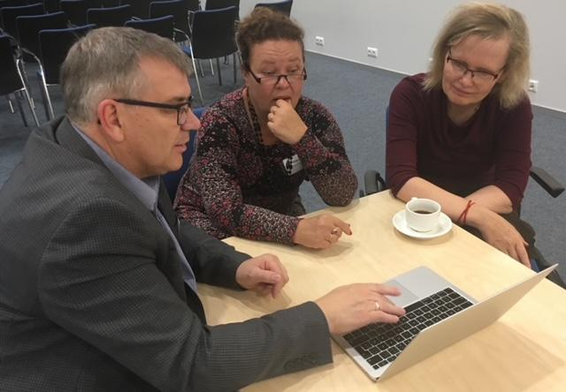
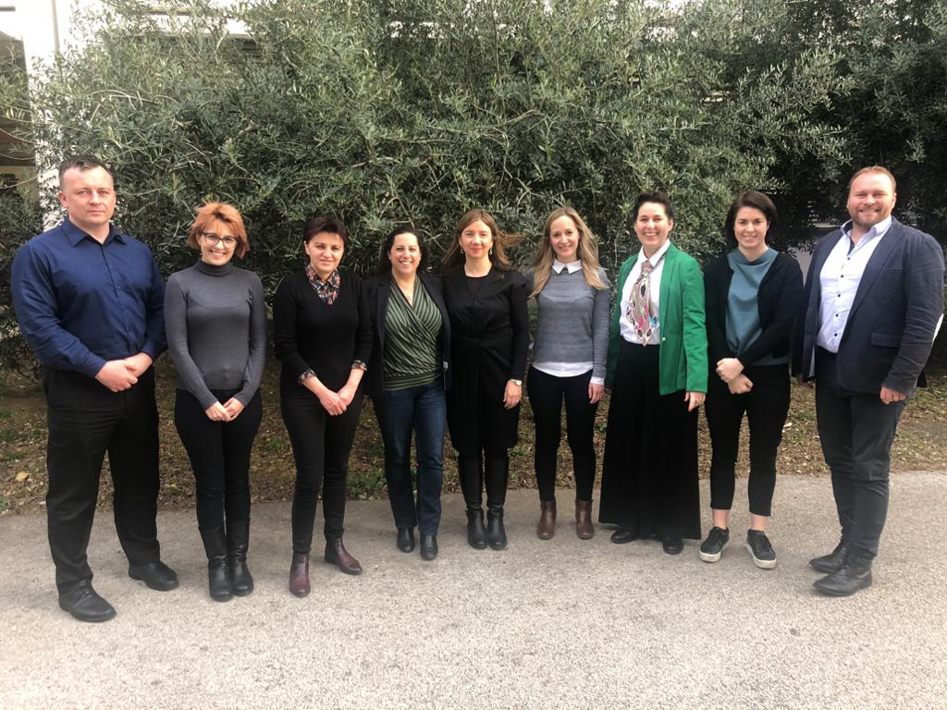
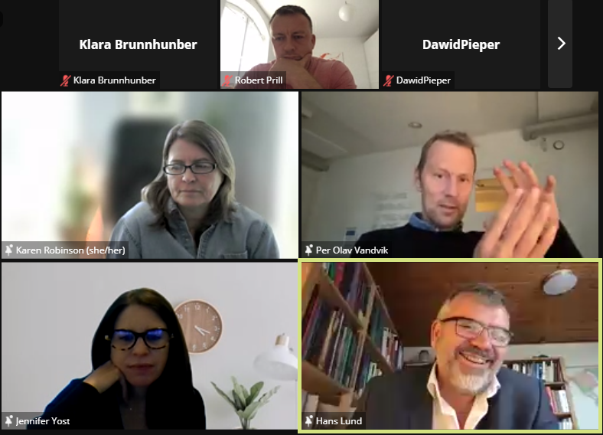
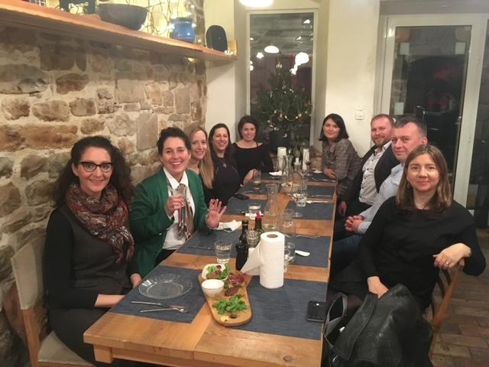
Fabulous 4.5 Years Together!

Slide 17
EVBRES has ended but the EBR journey continues – please join us!
ebrnetwork.org
@ebrnetwork
Sign up for the
Evidence-Based Research Newsletter to receive news about our exciting plans for 2024 and beyond

Slide 18
Our EBR Conferences To Date
Theme: “Increasing the Value of Research”
Dates: 16-17th November 2020 (Online)
Plenaries: The EBR Concept; Equipoise and EBR – the need to justify a new RCT; When is a further clinical trial justified?; What is meta-research, and what should we call it?; What is a “meta-research study”?; The METRIC project; Covid-19 and the EBR approach; The future for the EBR approach; The ethical aspect of EBR: the question of valuable research
1st EBR Conference
Theme: “The Place of Evidence-Based Research in the Evidence Ecosystem”
Dates: 27-28th September 2021 (Online)
Plenaries: Evidence Ecosystems and learning health systems: What are they and why bother?; The role of EBR in the Evidence Ecosystem; Involvement of end users in research when planning new research; How to involve end users in the planning of new research in a more systematic and transparent way; Access to and availability of evidence synthesis; More efficient production, updating and dissemination of evidence syntheses; The role of EBR in the knowledge to action cycle; The challenges of implementing EBR in different research environments
2nd EBR Conference
Theme: “Seeing Further: The Past, Present and Future of Evidence-Based Research”
Dates: 6-7th October 2022 (Online)
Plenaries: Making EBR possible, easier, and the norm: funders’ and researchers’ roles; Quality of clinical trials and its relation with research integrity; Answering the four statements on expectations of editors; Has registration succeeded in minimizing redundancy in systematic reviews?; How to avoid redundancy in systematic reviews?; A case on exercise for patients with knee osteoarthritis; Using a Bayesian approach to decide on the conclusiveness of systematic reviews; Introducing the Global Commission on Evidence; What has changed since the paper from 1996: Are research ethics committees behaving unethically?; The present and future of EBR in the light of the 1998 paper
3rd EBR Conference

