Slide 1
What is Evidence-Based Research (EBR)?
Hans Lund
Professor, Section Evidence-Based Practice
Western Norway University of Applied Sciences
Bergen Campus

Slide 2

Imagine ...
... you are having a great idea for a new scientific study

Slide 3
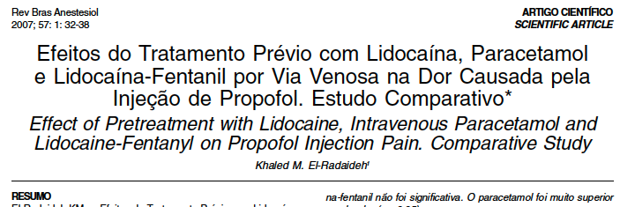
An example
From
El-Radaideh KM. Effect of pretreatment with lidocaine, intravenous paracetamol and lidocaine-fentanyl on propofol injection pain. Comparative study. Rev Bras Anestesiol 2007;57:32-8.

Slide 4
An example:
Chain of arguments in the Background
Propofol the most common drug for induction of
general anaesthesia
Pain on injection a major problem
Several methods to reduce the
pain associated with i.v. injection of propofol
Recent studies showed that pre-medication with lidocaine diminish the intensity of pain
Purpose was to assess the efficacy of lidocaine on diminish pain associated with the injection of propofol
From
El-Radaideh KM. Effect of pretreatment with lidocaine, intravenous paracetamol and lidocaine-fentanyl on propofol injection pain. Comparative study. Rev Bras Anestesiol 2007;57:32-8.

Slide 5
An example:
Chain of arguments in the Background
Propofol the most common drug for induction of
general anaesthesia
Pain on injection a major problem
Several methods to reduce the
pain associated with i.v. injection of propofol
Recent studies showed that premedication with lidocaine diminish the intensity of pain
purpose was to assess the efficacy of lidocaine on diminish pain associated with the injection of propofol
RESULTS:
Lidocaine significantly reduced propofol injection pain more than placebo (in 68 %)
(p < 0.05).
From
El-Radaideh KM. Effect of pretreatment with lidocaine, intravenous paracetamol and lidocaine-fentanyl on propofol injection pain. Comparative study. Rev Bras Anestesiol 2007;57:32-8.

Slide 6

However ...
This study by El-Radaideh (Submitted for publication 24 March 2006) turns out to be redundant and unnecessary – together with 86 other similar studies !

Slide 7
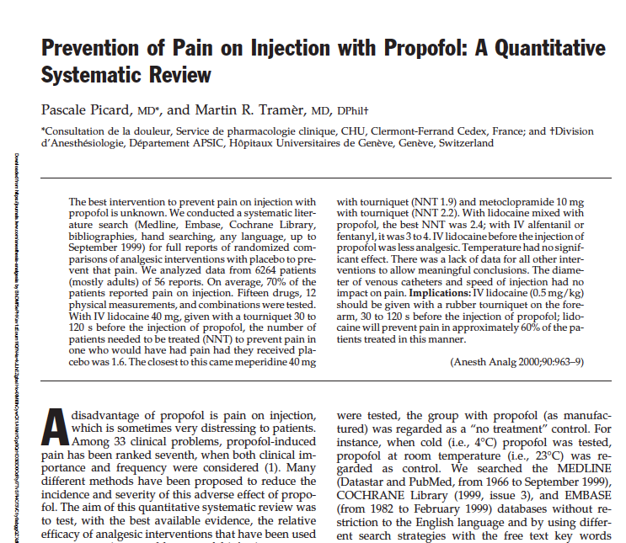
In 2000 ...
Picard & Tramér published a systematic
review in 2000 with this title:
Prevention of Pain on Injection with Propofol:
A Quantitative Systematic Review
They identified and included 56 studies
(with 6264 patients) and concluded:
“IV lidocaine (0.5 mg/kg) should be given with a rubber tourniquet
on the forearm, 30 to 120 s before the injection of propofol; lidocaine
will prevent pain in approximately 60% of the patients treated in this manner.”

Slide 8
Oh, but ...
... El-Radaideh did cited this review by Picard and Tramér:
From the Discussion section:
“The incidence of pain on injection of propofol has been reported to be 70% (Picard and Tramér, ref 19)” (Page 37).
However, the author did not mention or used the systematic review in any other way.
For example, to stop the author from performing the study!

Slide 9


Then ...
... in 2014, Celine Habré with
one of the systematic review
authors (Martin Tramér) and two
more, published an updated
systematic review:
“Ability of a meta-analysis to prevent
redundant research: systematic review
of studies on pain from propofol injection”
Céline Habre
Hôpitaux Universitaires de Genève | HUG · Service de radiologie

Slide 10
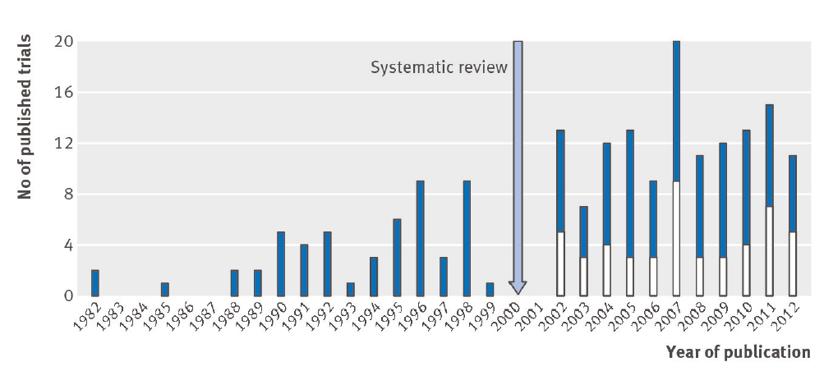
Habre et al. 2014

Slide 11
Habre et al. 2014
56 studies
(Picard & Tramér 2000)

Slide 12
Habre et al. 2014
136 NEW studies
since 2000
49 clinically relevant
87 REDUNDANT STUDIES
56 studies

Slide 13
Habre et al. 2014
136 NEW studies
since 2000
49 clinically relevant
87 REDUNDANT STUDIES
56 studies
El-Radaideh 2007 was one of these 87 redundant studies – even though the author was familiar with the 2000 review

Slide 14

Habre 2014
“There are numerous examples
where systematic reviews, if
performed in a timely manner,
could have provided evidence of
the effectiveness of an intervention
and thus, prevented redundant research.
There is also evidence that knowledge from
systematic reviews are underused to inform
future research.”

Slide 15

The overall evidence: when justifying a study
“The mean percentage of original studies using systematic reviews to justify their study was 42%
(95% CI: 36% to 48%).”
In other words:
58% were not using SRs to justify their study

Slide 16

The overall evidence: when designing a new study
The mean percentage of original studies using systematic reviews to inform the design was 17% (95% CI: 6% to 33%).”
In other words:
83% were not using SRs to inform their design of their new study

Slide 17

The overall evidence: when placing new results in context of existing evidence
The mean percentage of original studies using systematic reviews to place new results in context was 31%
(95% CI: 24% to 38%).”
In other words:
69% were not using SRs to inform their design of their new study

Slide 18
How to deal with that?

Slide 19
An international network
If you like to know more go to:
ebrnetwork.org

Slide 20
The EBRNetwork define EBR
EBR is the use of prior research in a systematic and transparent way to inform a new study so that it is answering questions that matter in a valid, efficient, and accessible manner

Slide 21

The elements of an EBR approach

Slide 22
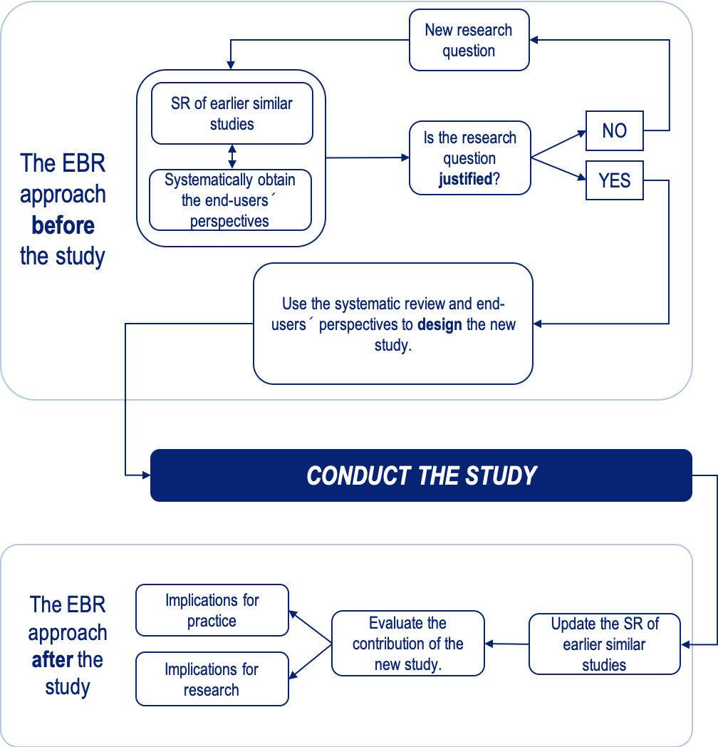
The EBR approach

Slide 23
An example:
Chain of arguments in the Background
Propofol the most common drug for induction of
general anaesthesia
Pain on injection a major problem
Several methods to reduce the
pain associated with i.v. injection of propofol
Recent studies showed that pre-medication with lidocaine diminish the intensity of pain
Purpose was to assess the efficacy of lidocaine on diminish pain associated with the injection of propofol
Here should the author(s) have have used the systematic review from 2000!
From
El-Radaideh KM. Effect of pretreatment with lidocaine, intravenous paracetamol and lidocaine-fentanyl on propofol injection pain. Comparative study. Rev Bras Anestesiol 2007;57:32-8.

Slide 24
An example:
Chain of arguments in the Background
The author(s) did so – BUT, the systematic review by Picard and Tramér should have been used to JUSTIFY and DESIGN – and even placing the results in CONTEXT of existing evidence
Propofol the most common drug for induction of
general anaesthesia
Pain on injection a major problem
Several methods to reduce the
pain associated with i.v. injection of propofol
Recent studies showed that pre-medication with lidocaine diminish the intensity of pain
Purpose was to assess the efficacy of lidocaine on diminish pain associated with the injection of propofol
Here should the author(s) have have used the systematic review from 2000!
From
El-Radaideh KM. Effect of pretreatment with lidocaine, intravenous paracetamol and lidocaine-fentanyl on propofol injection pain. Comparative study. Rev Bras Anestesiol 2007;57:32-8.

Slide 25
Thank you for your attention
If you like to know more go to:
ebrnetwork.org

