Slide 1
Evidence-Based Research
Network
Karen A. Robinson, PhD
Professor
Johns Hopkins University
Evidence-Based Research Seminar
December 2023

Slide 2

EBR Network
December
2014
EBR Network
2014

Slide 3
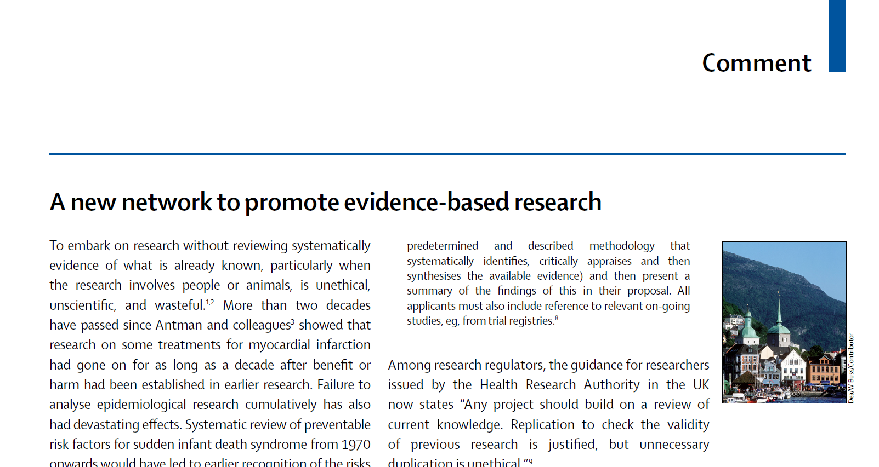
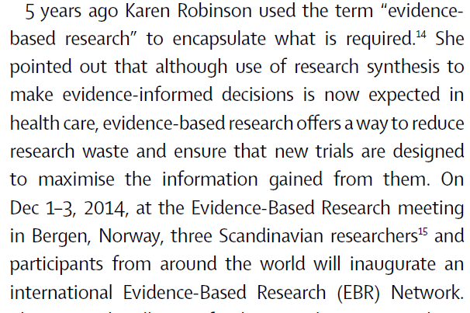


Chalmers I, Nylenna M. A new network to promote evidence-based research. Lancet. 2014 Nov 29;384(9958):1903-4. doi: 10.1016/S0140-6736(14)62252-2. PMID: 25435440.

Slide 4
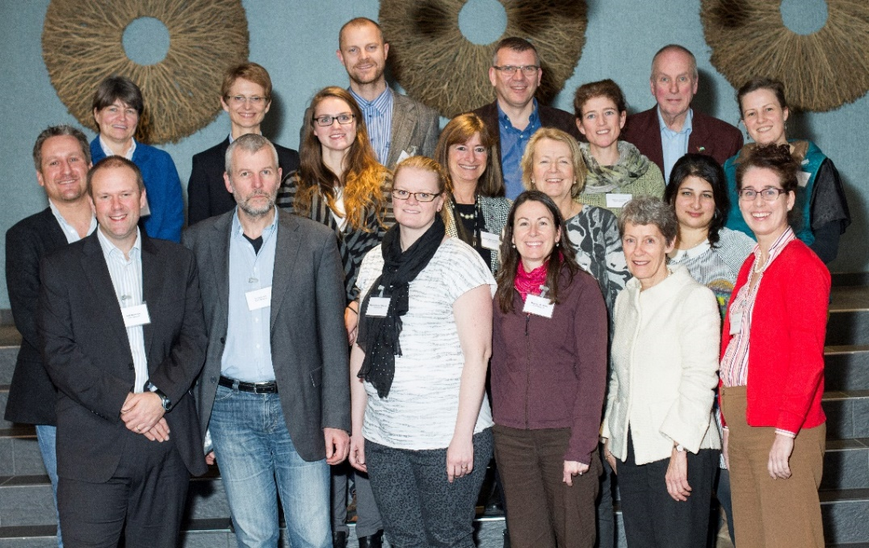
Principles:
No new research studies without prior systematic review of existing evidence
Efficient production, updating, and accessibility of systematic reviews
Bergen, 2014

Slide 5

EBR Network
December
2014
October
2018
EBR Network
EVBRES
(2018-2023)
2014
2018
1964

Slide 6

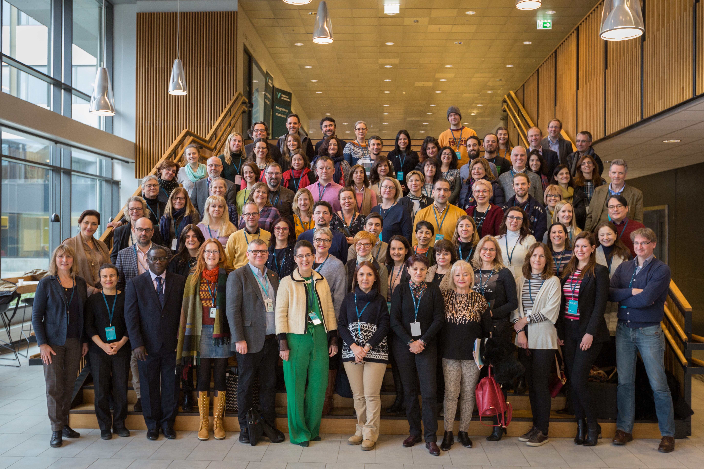
Bergen 2019

Slide 7
Toronto Framework
2018
Characterise issue/problem
Quantify prevalence of issue/problem
Quantify consequences of issue/problem
Identify barriers/facilitators EBR-approach
Identify predictors of using EBR-approach
Design and implement interventions to address barriers/facilitators identified
Evaluate implementation
Disseminate

Slide 8
Toronto Framework
1. Meta-research in EBR
Aim 1
Characterize the issue/problem
Aim 2
Quantify the prevalence of the issue/problem
Aim 3
Quantify the consequences of the issue/problem
Aim 4 Monitoring the status of the problem
Aim 5 Indicators for EBR
Aim 6 Research to improve meta-research in EBR
2. Developing EBR
Aim 7 Research related to systematically using Earlier Similar Studies (J, D, C)
Aim 8 Research related to meeting end users’ needs (J,D,C)
Aim 9 Research related to perform research prioritization processes
NEW Aim 10
Research related to more efficient production, updating and dissemination of systematic reviews
3. Implementing EBR
Aim 11 Identify barriers / facilitators using an EBR-approach
Aim 12 Design intervention(s) of using an EBR-approach in an efficient way
Aim 13 Identify predictors and Implement an EBR approach
Aim 14 Evaluate implementation of EBR
Versions: 2018, 2019, 2022, 2023

Slide 9

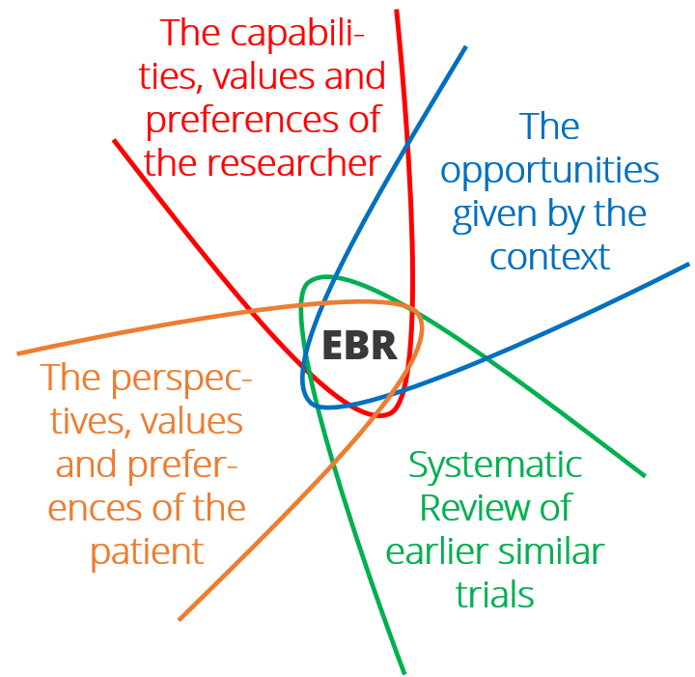
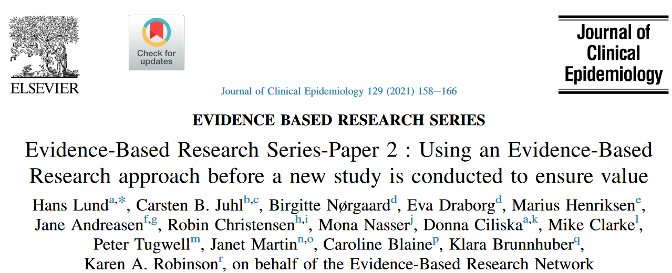
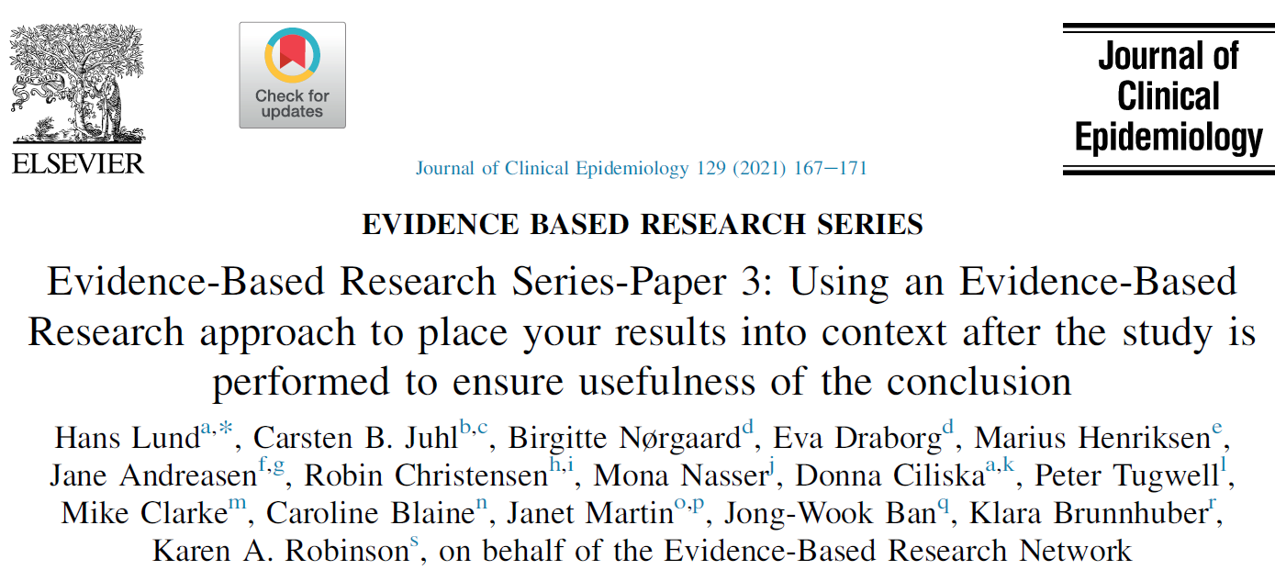

Slide 10


EBR Network
December
2014
October
2018
November2020
September 2021
October 2022
EBR Network
EVBRES
(2018-2023)
1st EBR Conference
2nd EBR Conference
3rd EBR Conference
1st EBRN General Assembly
Founding SG EBRN
2020
2014
2022
2018
1964

Slide 11


Slide 12

Founding Steering Committee:
Caroline Blaine, BMJ, UK
Klara Brunnhuber, Elsevier Ltd, UK
Miloslav Klugar, IHIR CR, Czech Republic
Hans Lund, Western Norway University of Applied Sciences, Norway
Mona Nasser, Plymouth University, UK
Karen Robinson, Johns Hopkins University, USA
Jennifer Yost, Villanova University, USA

Slide 13
Strategy
Vision
A world in which the cultural norm and expectation is that decisions about research are based on transparent and systematic use of evidence.
Mission
Transparent and systematic use of evidence to inform decisions about research

Slide 14
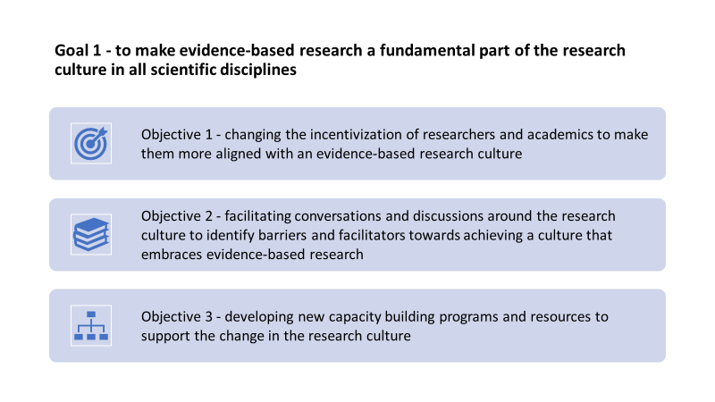
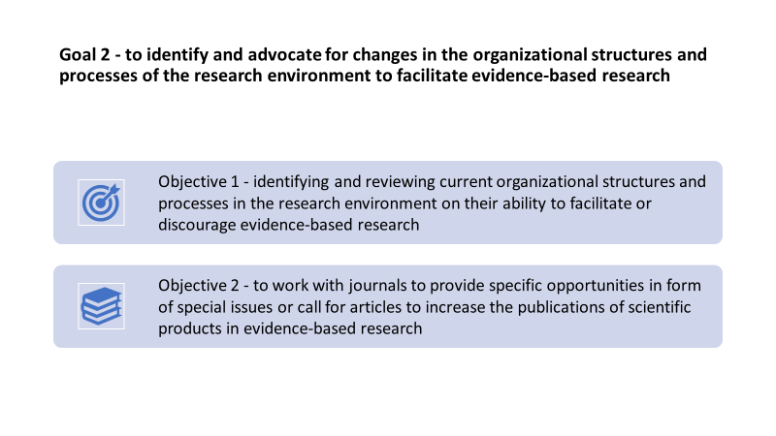
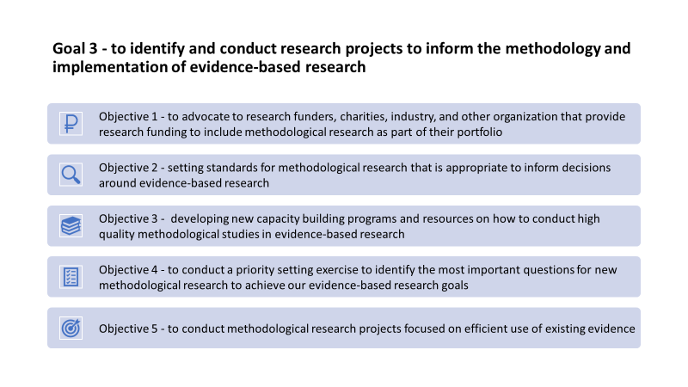
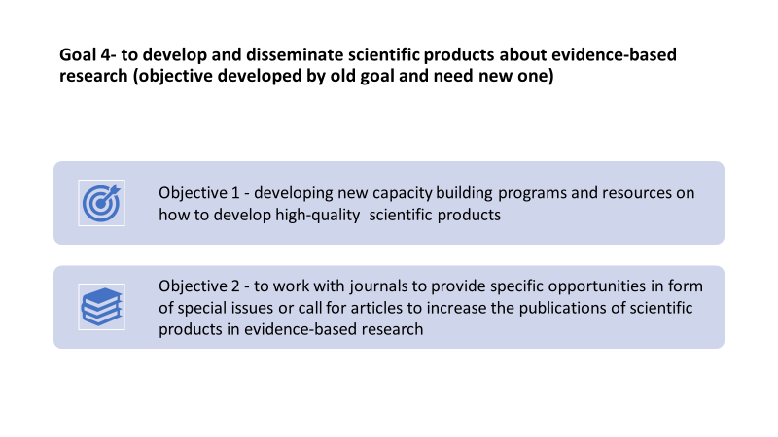

Slide 15

Charter
Three main sections:
General information about EBRNetwork
Name, based in Norway, not-for-profit, purpose, hosted by an institution through an associated agreement
Governance structure
Board of Trustees, Secretariat, Steering Committee, Founding Steering Committee, Members, Subcommittees
Membership, key regulations, processes & policies
Eligibility, categories, voting rights, annual dues, resignation & termination, meetings, Conflict of Interest, financial aspects & audit, use of outside experts, amendments to Charter/Strategy/Business model, dissolution of EBRNetwork

Slide 16
Business Model
Financial administration details
Funding sources:
  Membership fee
  Grants
  Sponsorships
  Revenue from products, events and services
  Donations

Slide 17

EBR Network
December 2014
October 2018
November2020
September 2021
October 2022
December 2023
September2024
EBR Network
EVBRES
(2018-2023)
1st EBR Conference
2nd EBR Conference
3rd EBR Conference
1st EBRN General Assembly
Founding SG EBRN
EBR Seminar
4th EBR Conference
2nd General Assembly
Elected SG EBRN
2020
2024
2014
2022
2018
1964

Slide 18
Join the EBR Network!
You will support the promotion of EBR
You will receive a discount for EBR conferences, webinars, courses, etc.
You will have opportunity to participate in development and discussion related to EBR
You will have opportunity to participate in EBR related research and publications
and more!
Sign up for the EBRNetwork newsletter (ebrnetr

Slide 19

Come to the 4th EBR Conference and 2nd General Assembly!
9 September 2024
ebrnetwork.org
www.globalevidencesummit.org

Slide 20
Evidence-Based Research – The Future?
EBR Network
Move beyond health care

Slide 21

EBRNetwork seminar/workshop
Advancing Evidence-Based Research: Trends and Insights

